Slide 1
Introduction to SUSE Studio
Your name here!
Notes:
Welcom! I am...

Slide 2

Notes:
I'll be talking about SUSE Studio, a SUSE product build upon the Open Build Service, KIWI and other openSUSE technologies.

Slide 3

Notes:
SUSE Studio is a web interface to build appliances, letting you take advantage of the powerful infrastructure SUSE has build.

Slide 4




Application
Pre-configured
Application
Image
Configuration
OS
Notes:
An appliance is a combination of an application, configuration and OS in one.

Slide 5

Pre-Formatted As
Live CD
Bootable USB
ISO
Software
Image
Pre-Formatted For
VMware
Xen
KVM
Virtual
Image
Pre-Formatted For
Cloud
Image
Amazon EC2
Pre-Installed On
Hardware
Image
x86 32- and 64-bit
Notes:
You can run an appliance in a Virtual Machine, in the cloud or directly on hardware.

Slide 6
Notable Features Include...
Configure everything once (users, network, etc.)
Upload custom files, scripts, applications
Test Drive “appliance” directly in your web browser
  Save modifications back to your appliance
  Direct deployment to clouds!
Notes:
Two really impressive features are the testdrive, where your appliance runs on the SUSE Servers and you can connect via VNC; and the direct deployment to EC2 and other clouds.

Slide 7
You Might Care if...
You want repeatable VM deployments
You want to make demo CDs, VM's etc
You want to build your own portable OS
You're an ISV
You've been given a SUSE appliance based application by an ISV
Notes:
Studio rocks to create images for testing or live CD's and such.
It's perfect to build your own operating system on a stick – given a reasonably fast and big USB stick you have your portable OS anywhere, anytime!
Or to get your software out there in an easy to use, pre-configured form
ISV building software appliance, IHV (“perfect myth box?”, “ultra easy to deploy network monitor”)

Slide 8
I Should Probably Also Mention...
SUSE Studio Onsite is available for purchase
  Use it inside your firewall
  comes with lifecycle management of the appliances (updating, managing etcetera)
SUSE Studio is actually a frontend for KIWI and the Open Build Service
  http://en.opensuse.org/Portal:KIWI
  http://openbuildservice.org
There's also susegallery.com, for
sharing appliances (think of it as
apppstore for appliances)
Notes:
Studio is a web interface over openSUSE technology like KIWI and the Open Build Service
Thus it offers import and export features to those tools
The web interface is however a proprietary layer, available for purchase.

Slide 9

Time for a Walkthrough

Slide 10
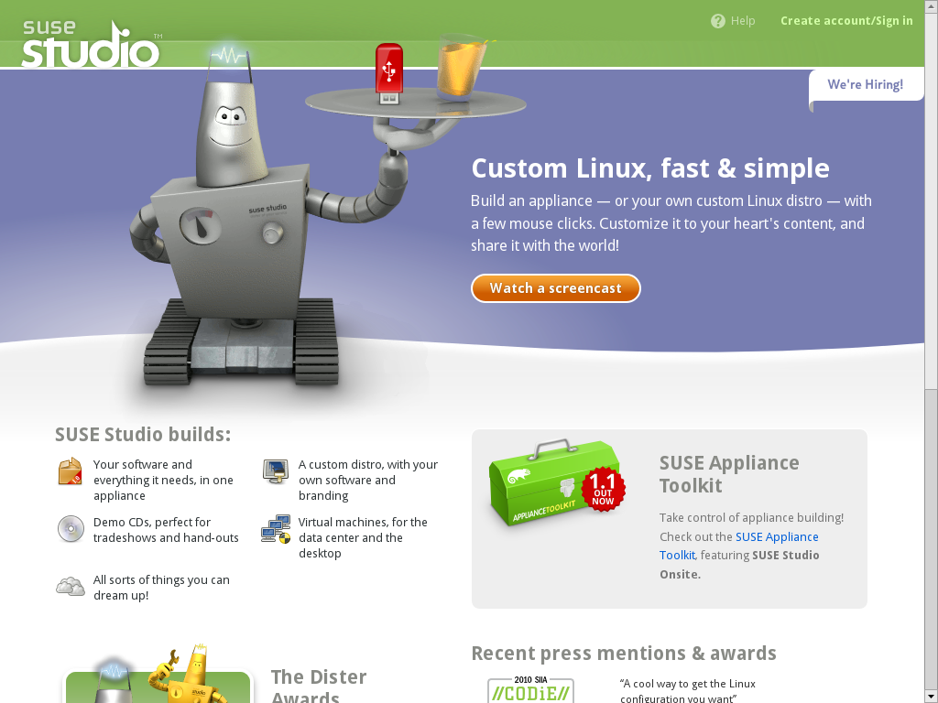
Notes:
Welcome!

Slide 11
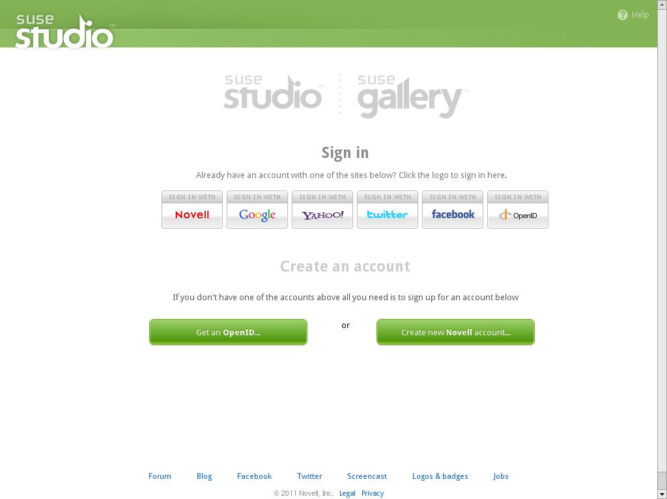
Notes:
Log in any way you want.

Slide 12
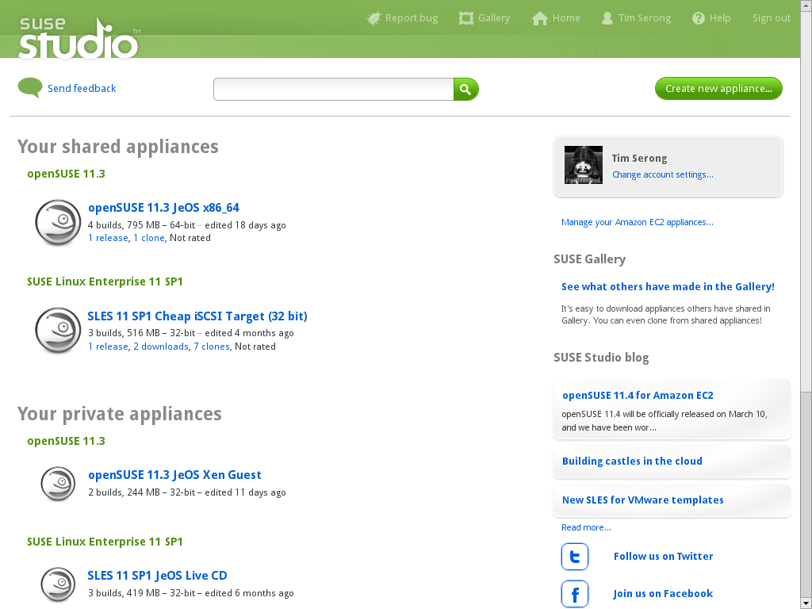
Notes:
Your 'home' overview.
Now let's click 'create new appliance' and get going!

Slide 13
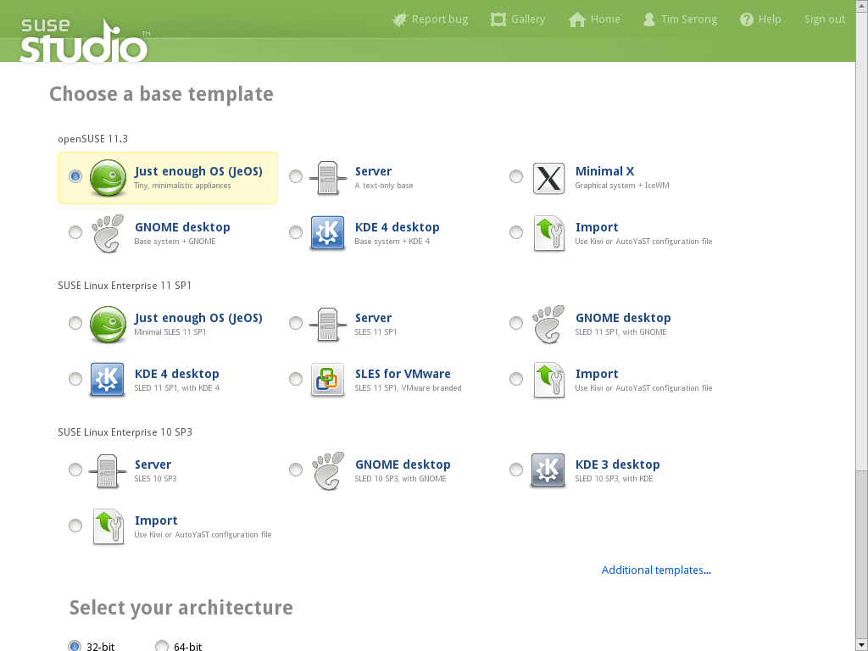
Notes:
We pick a base template...

Slide 14
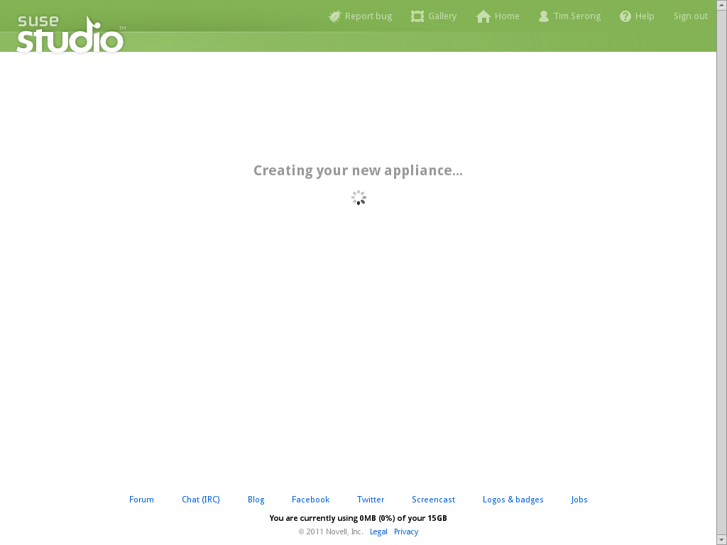
Notes:
Studio loads it...

Slide 15
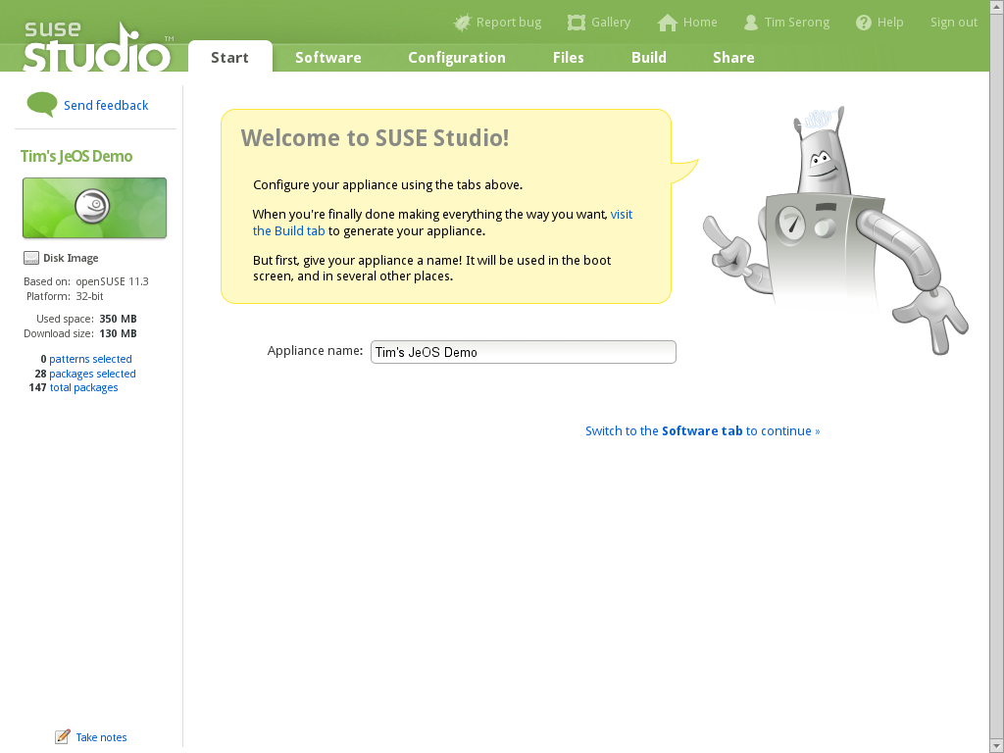
Notes:
And we can get started!

Slide 16
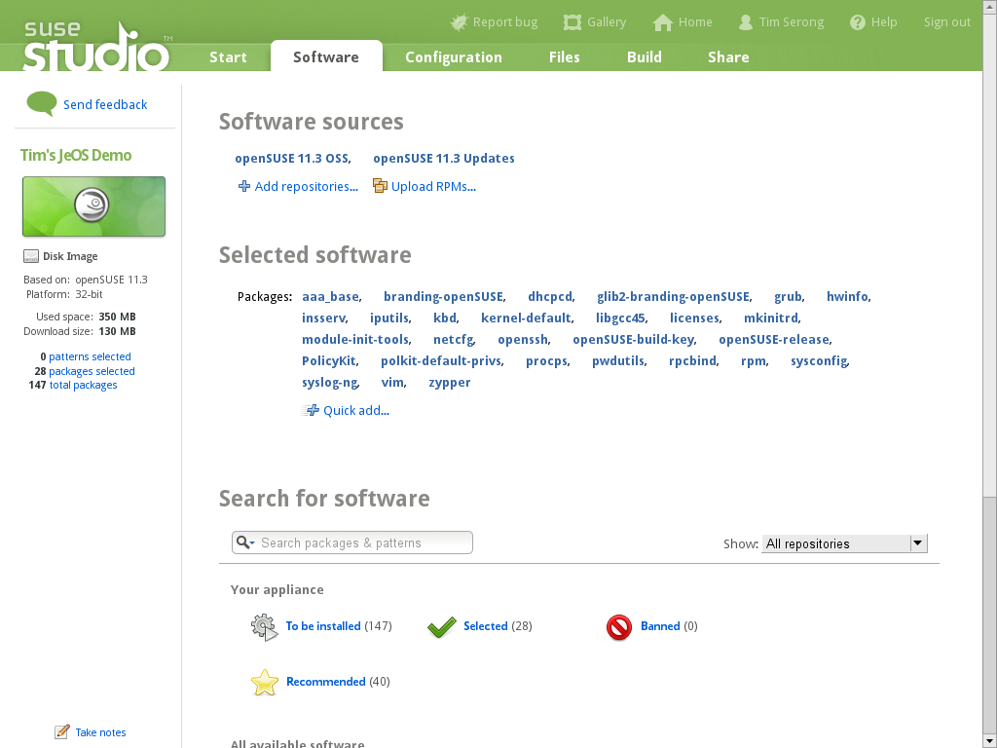
Notes:
Here's the start – only a basic OS is there. You can add repo's and software, if you want...
You have access to all the repo's of the Open Build Service, we're talking about tens of thousands with over a 150.000 packages in them!
Of course you can add external repo's or upload your own packages directly.

Slide 17
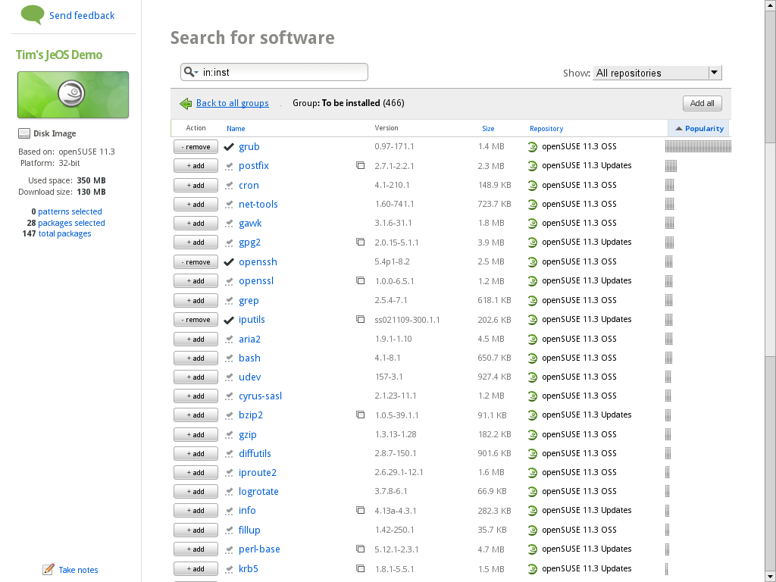
Notes:
Here's a view of the currently (to be) installed software.

Slide 18
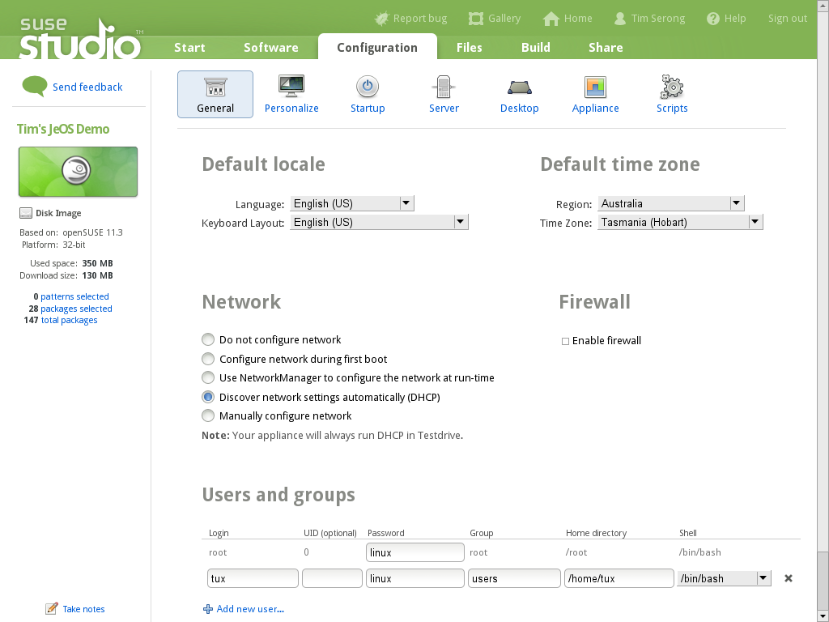
Notes:
After software selection we set up our OS. Language, timezone, network, users... The usual.

Slide 19
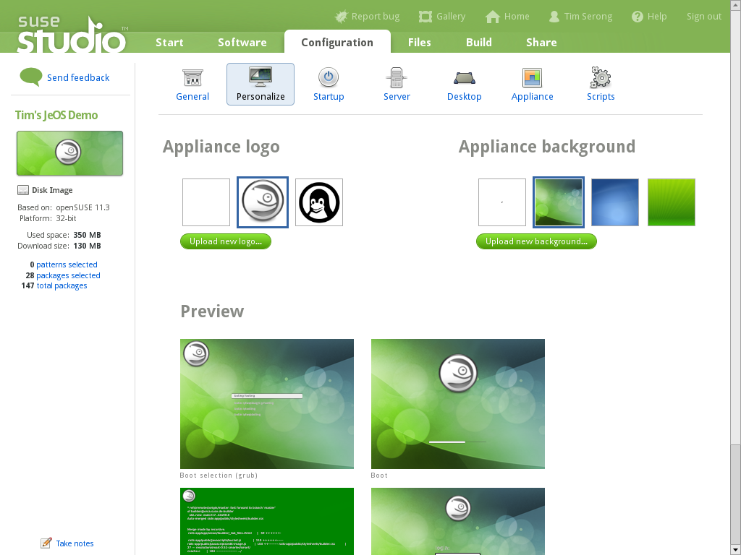
Notes:
Including of cours all branding, as custom as you want!

Slide 20
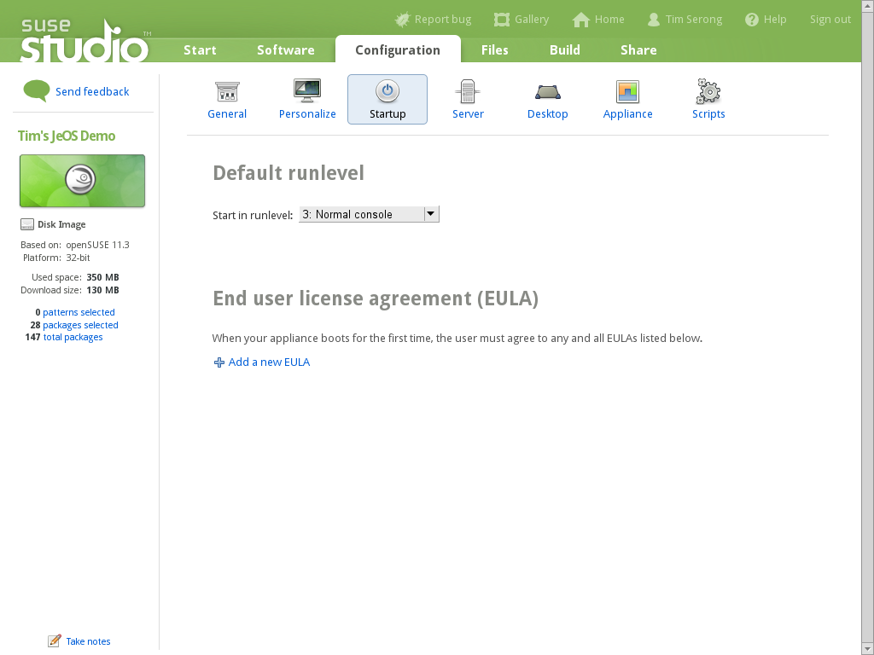
Notes:
You can even add your own EULA's if you like.

Slide 21
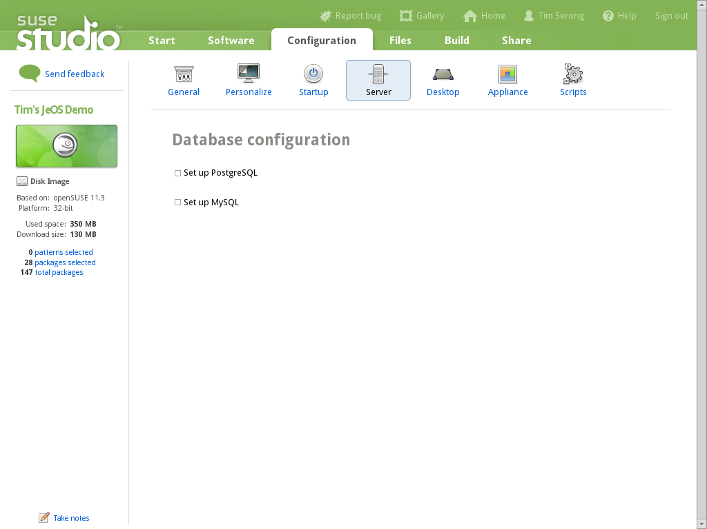
Notes:
… and set up databases

Slide 22

Notes:
If you configure a database which is not installed, Studio will offer a one-click-install-the-database for you.

Slide 23
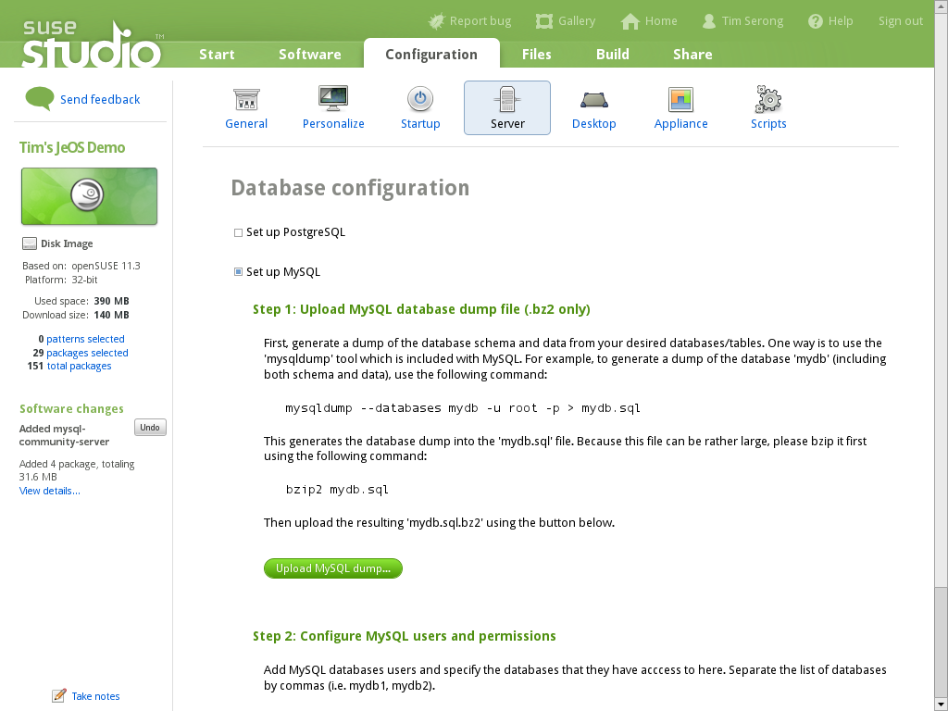
Notes:
All done! Details?

Slide 24
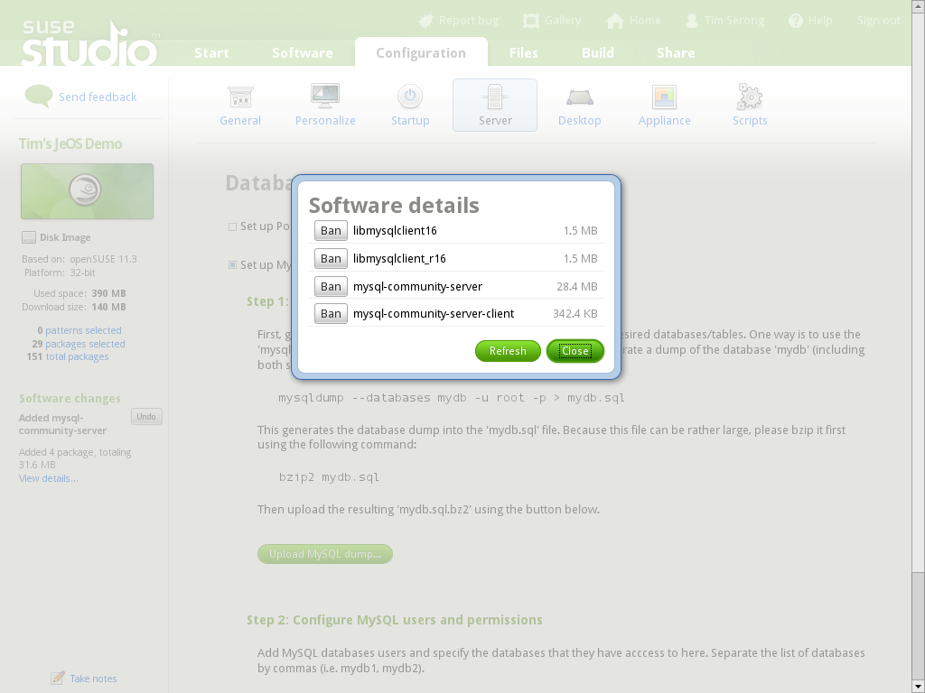
Notes:
Let's see what Studio just did...

Slide 25
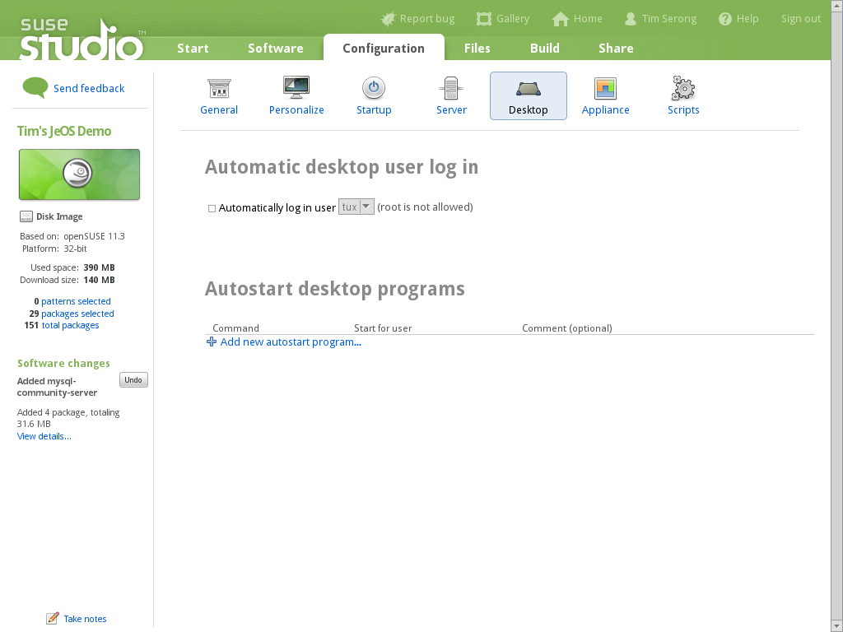

Slide 26


Slide 27
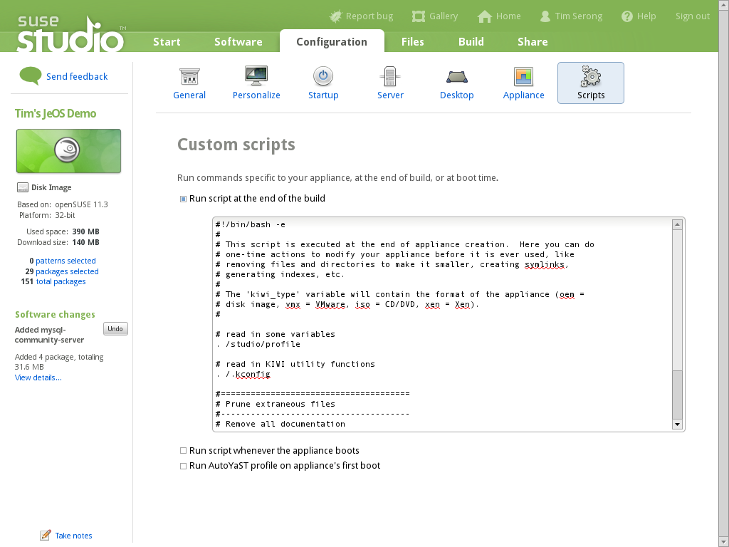
Notes:
Now we can add custom scripts, to be run whenever we want.

Slide 28
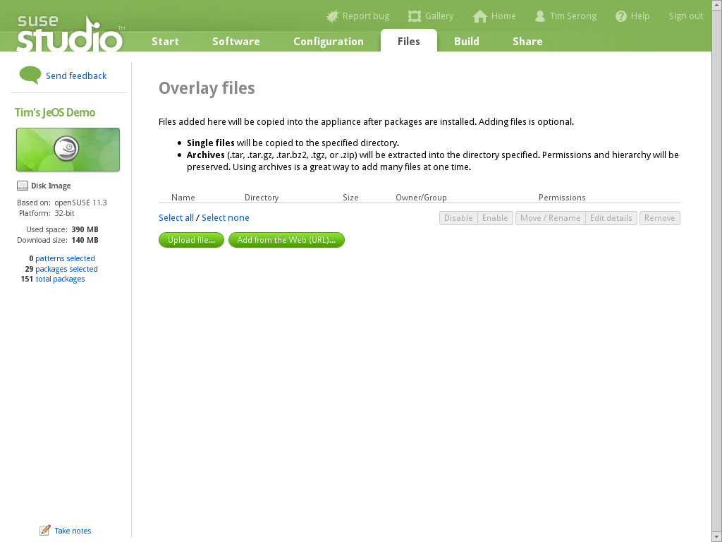
Notes:
And upload our own tarballs with software, to be extracted wherever we want!

Slide 29
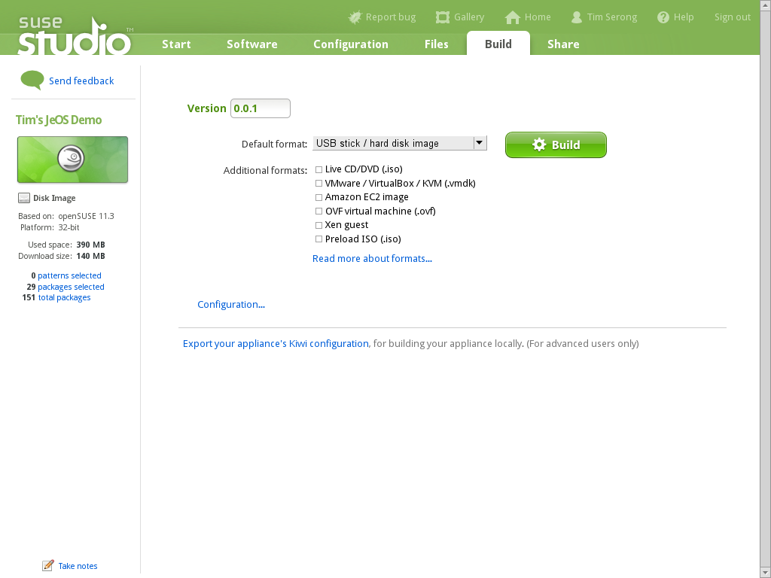
Notes:
After all that, we are ready to build our OS, or rather, let the SUSE servers do that for us.

Slide 30

Notes:
Notice that here you can also download the KIWI specification for further customization or building on your own workstation!
The sizes mentioned are guestimations, by the way.

Slide 31

Notes:
The building will take a while, about 5-20 minutes depending on the size of the OS.

Slide 32

Notes:
Ok, for very small OS'ses a few minutes usually is enough!

Slide 33
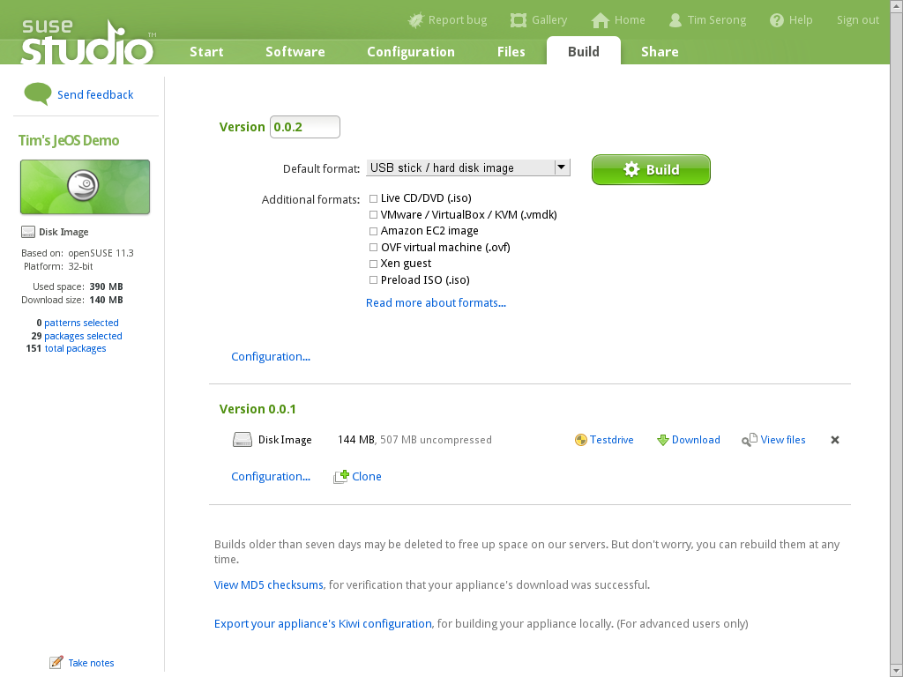
Notes:
Once done, we can start Testdrive!

Slide 34
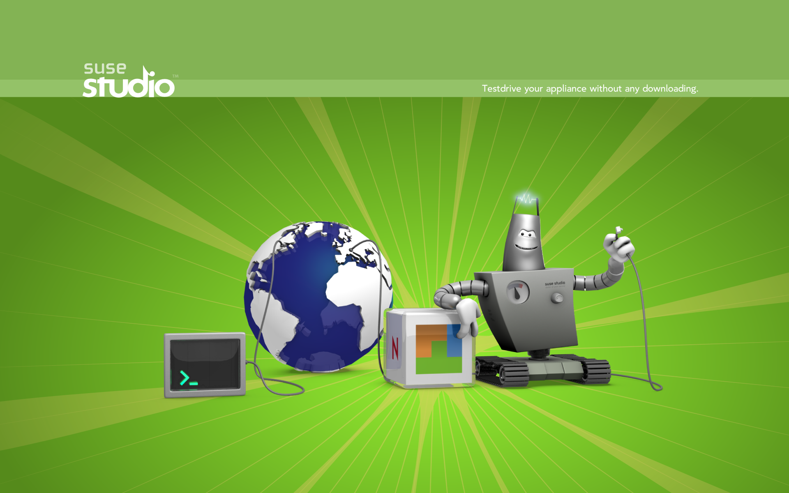
Notes:
Testdrive means booting up your appliance on the SUSE servers and interacting with it via either SSH or a regular or in-browser, flash based VNC session.

Slide 35
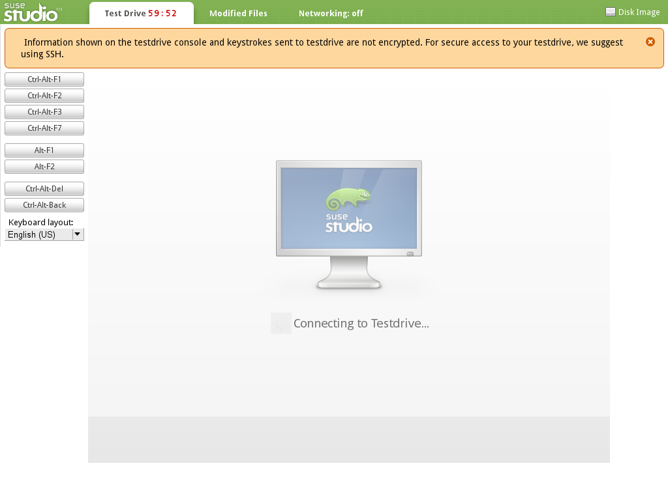
Notes:
So let's connect to the SUSE Servers via the flash based VNC tool...

Slide 36
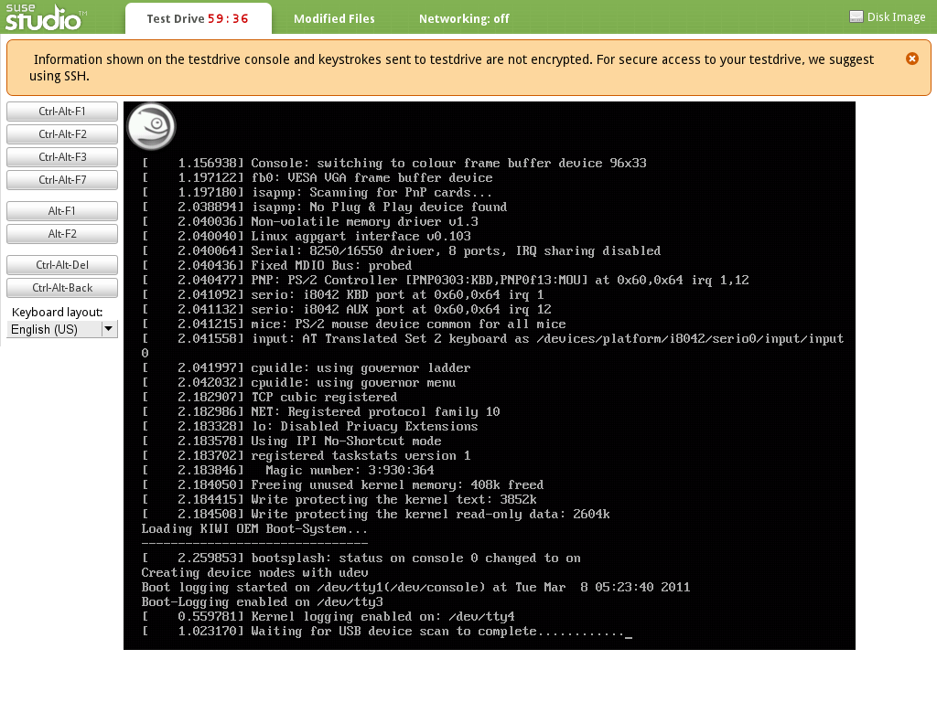
Notes:
And watch it boot up.

Slide 37
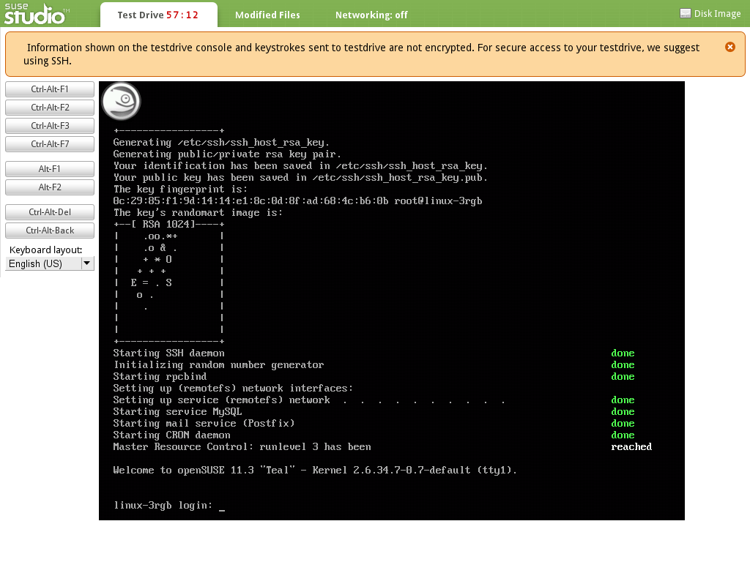
Notes:
And log into your newly build OS!

Slide 38
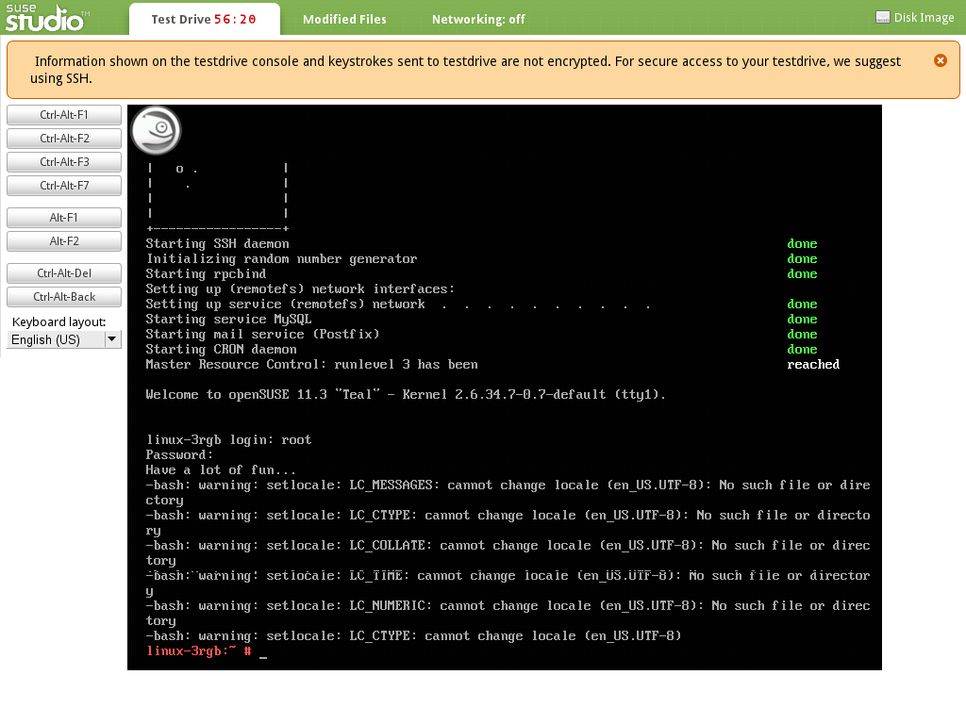
Notes:
Note locale errors. We should fix this...

Slide 39
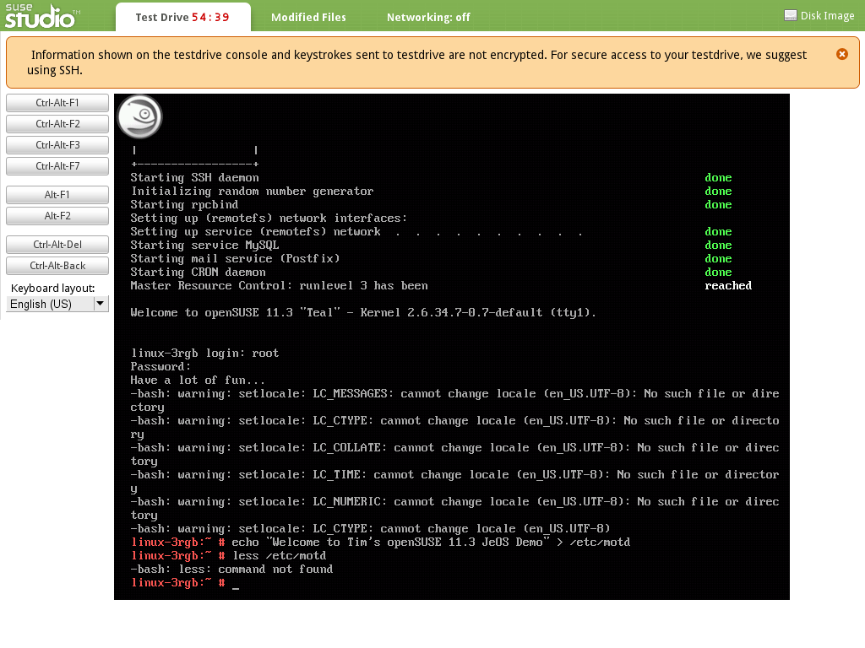
Notes:
Edited file
Note “less” is not installed, it's really minimal, this JeOS image...

Slide 40
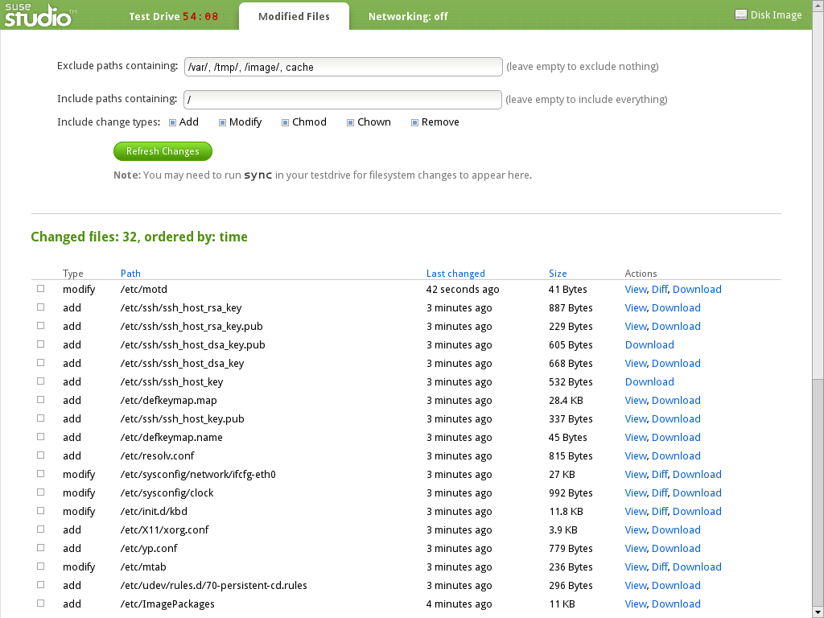
Notes:
Here you can get an overview of all the files changed during your test drive. You can include these in the image.

Slide 41
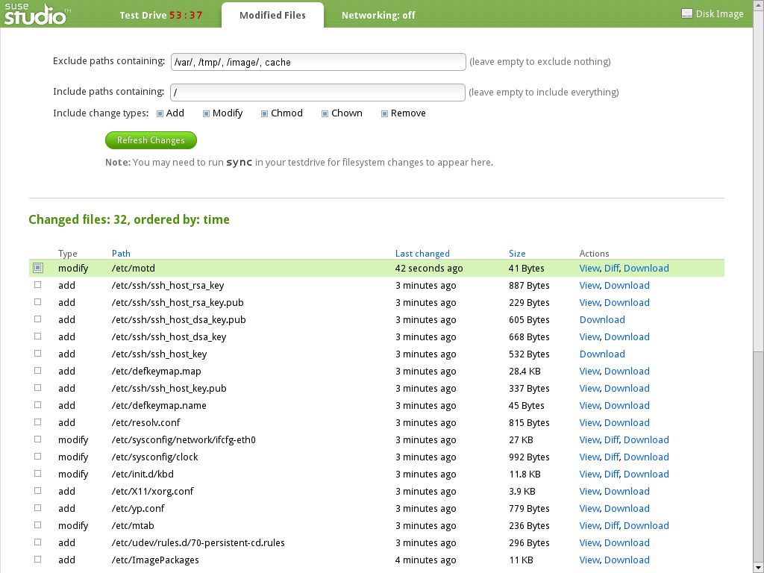
Notes:
Let's add this file to our appliance...

Slide 42
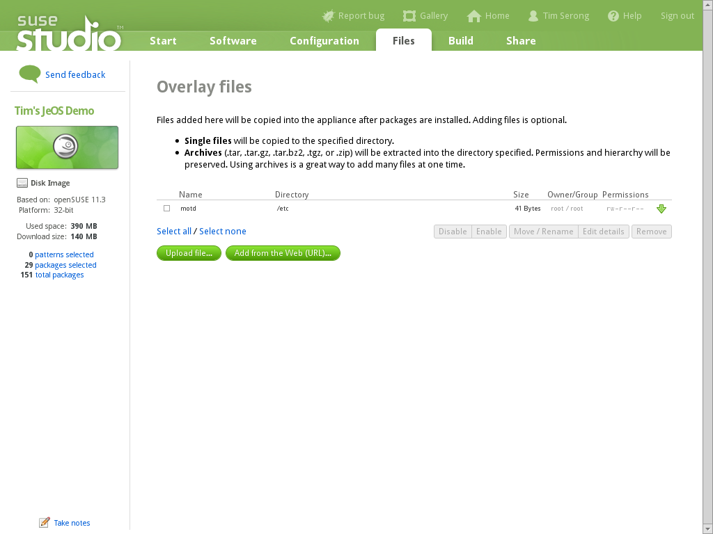
Notes:
Now it will show up here.

Slide 43
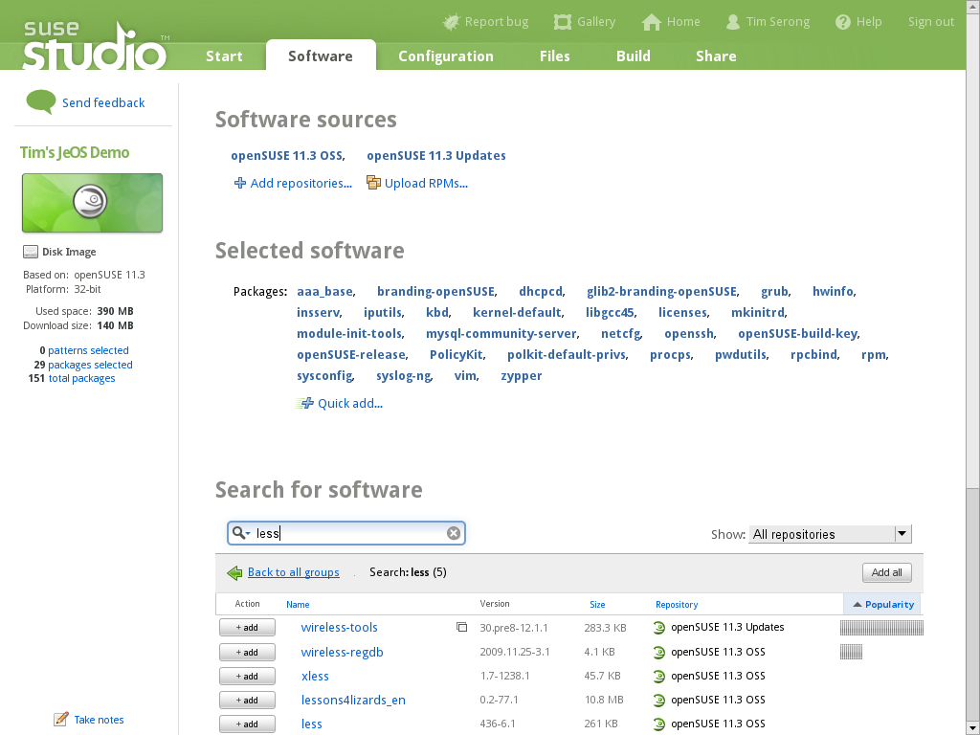
Notes:
And let's add less, we want that, don't we?

Slide 44
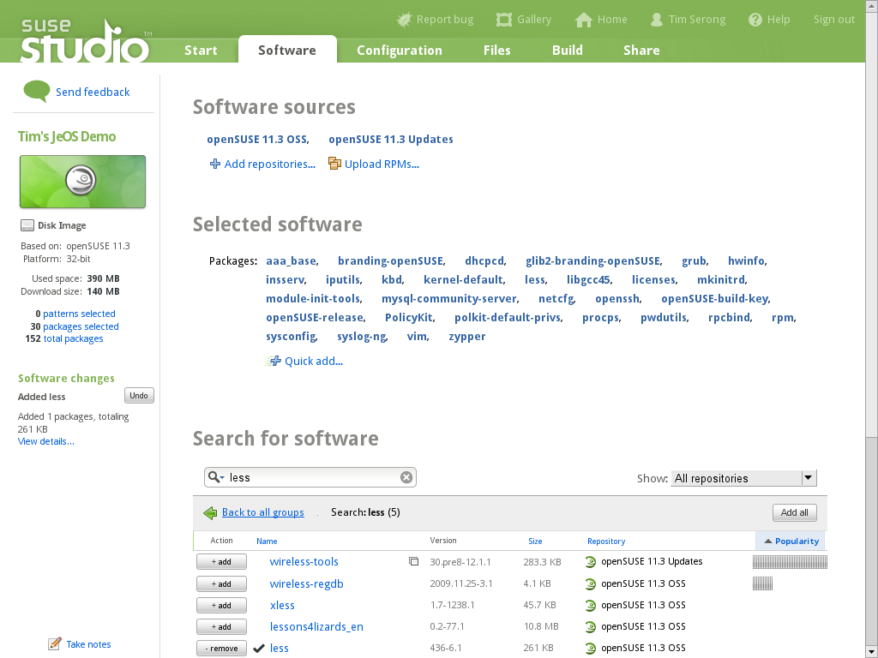
Notes:
Find “less” and add it!

Slide 45
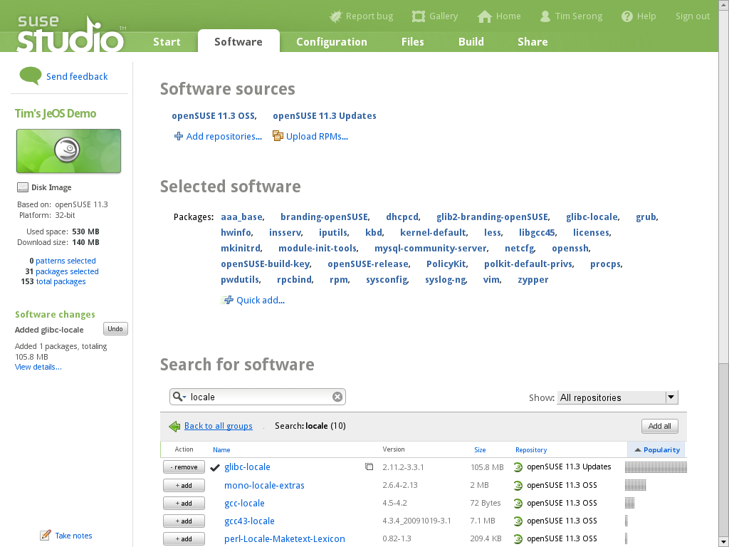
Notes:
Add “glibc-locale” to fix the locale errors too.

Slide 46
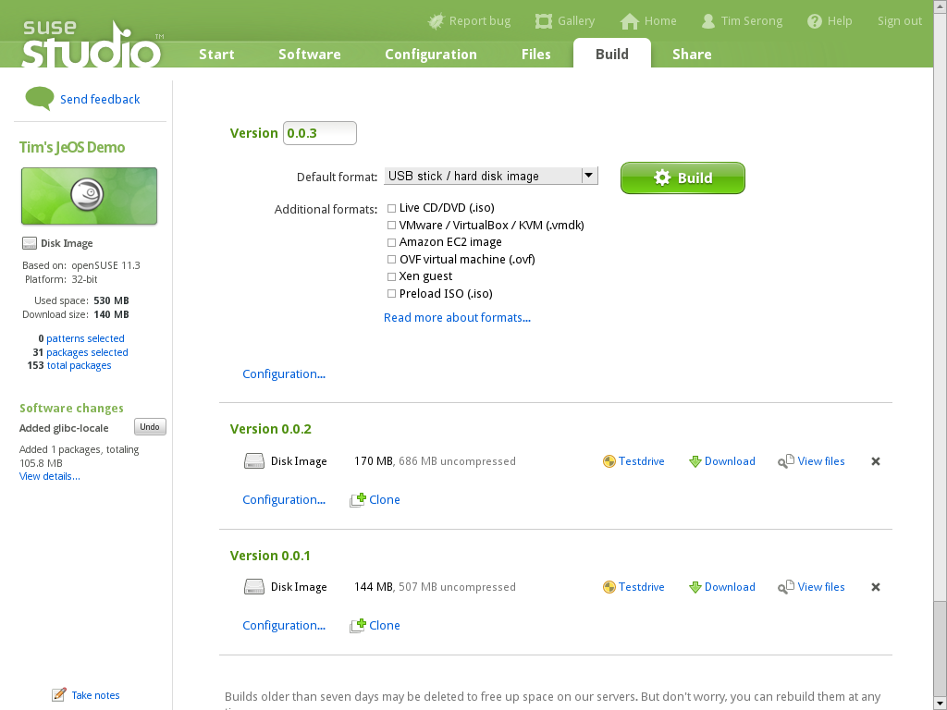
Notes:
Let's rebuild the thing. Note that we can add notes at any point, anywhere, and maintain a changelog. We're lazy so we don't...

Slide 47
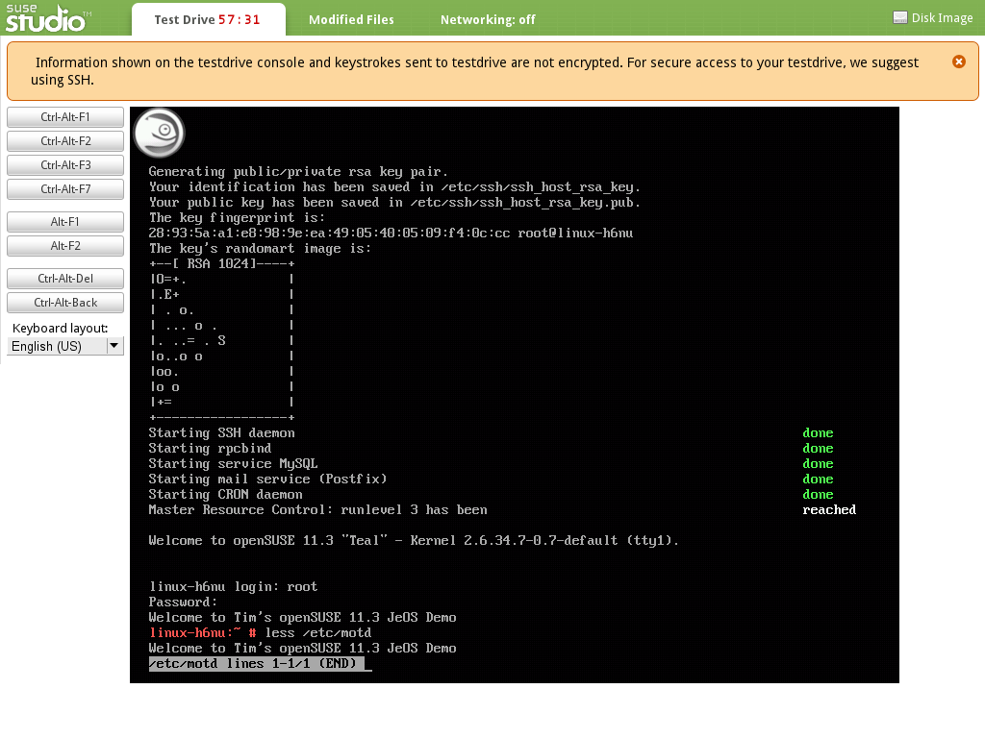
Notes:
File is there, no locale errors, less installed. Much better!

Slide 48
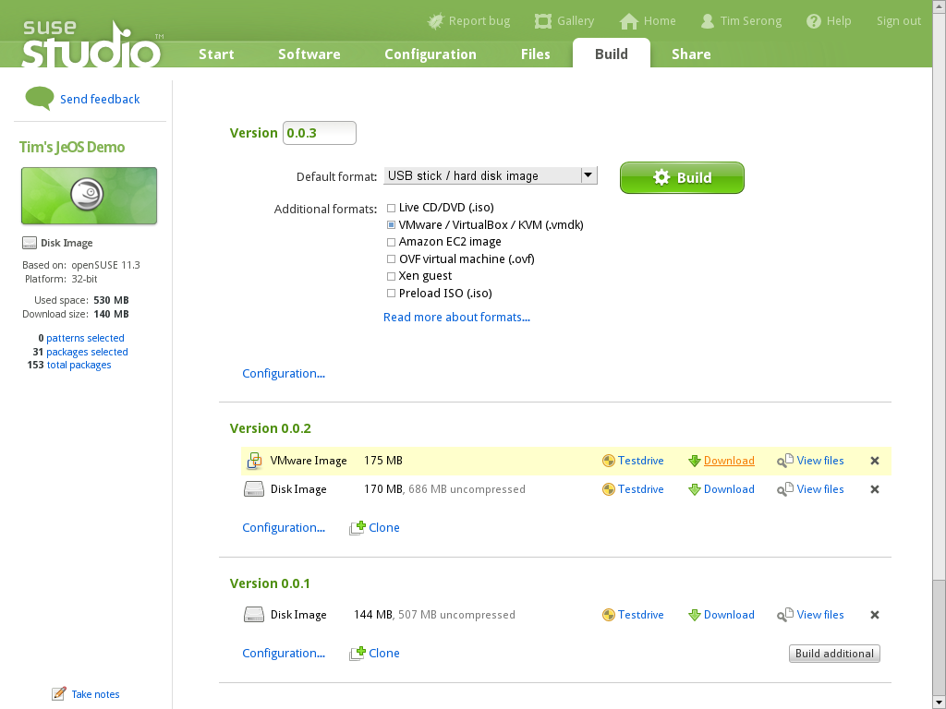
Notes:
Build and download VM so we can have it on our own server and start using it!

Slide 49
Let's Actually Deploy the VM Now...

Slide 50
A Quick Look at SUSE Gallery

Slide 51
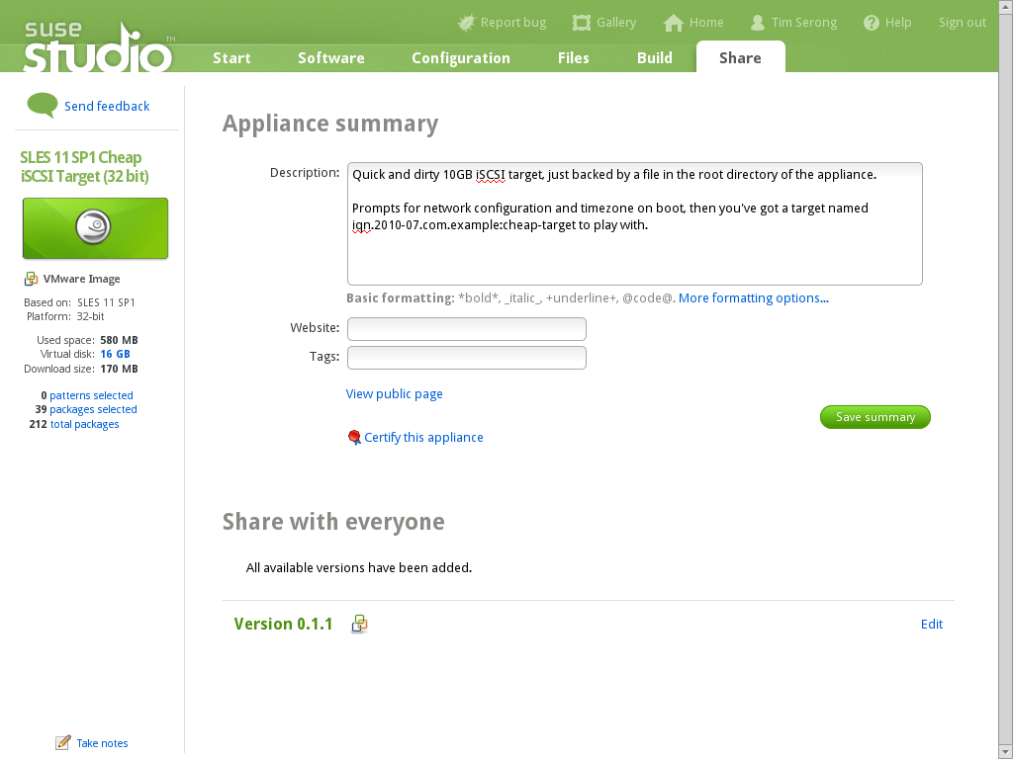
Notes:
Here's what it looks like to share the thing you made.

Slide 52
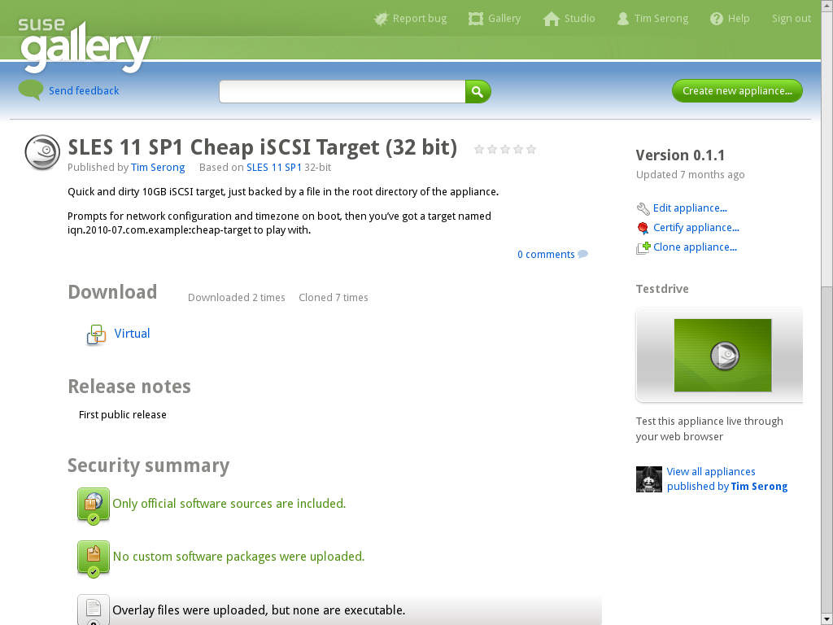
Notes:
Here's what everyone else sees
Note security info

Slide 53
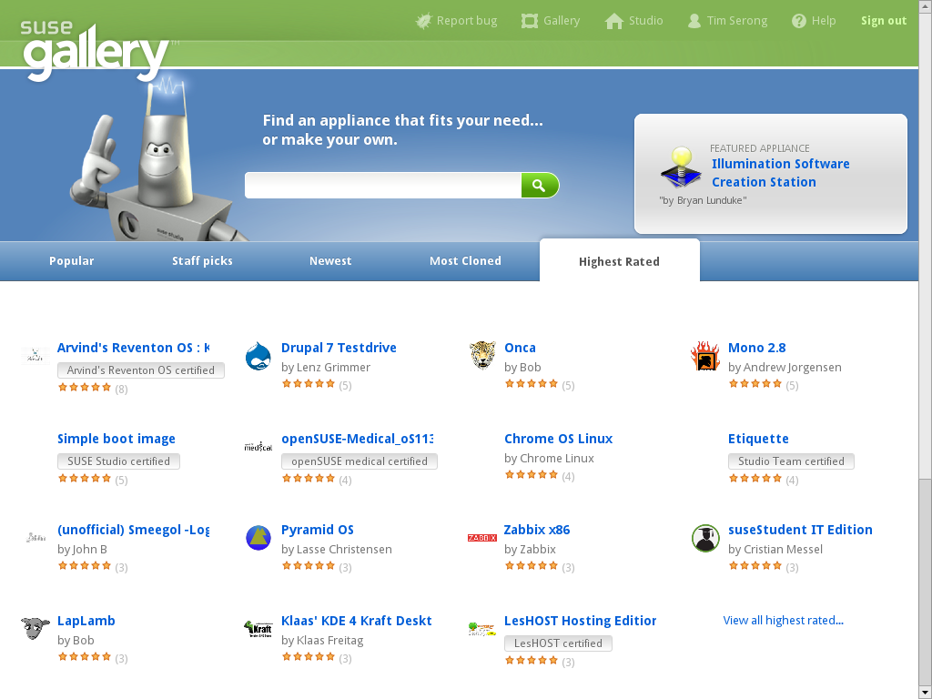
Notes:
Ratings, etc.

Slide 54
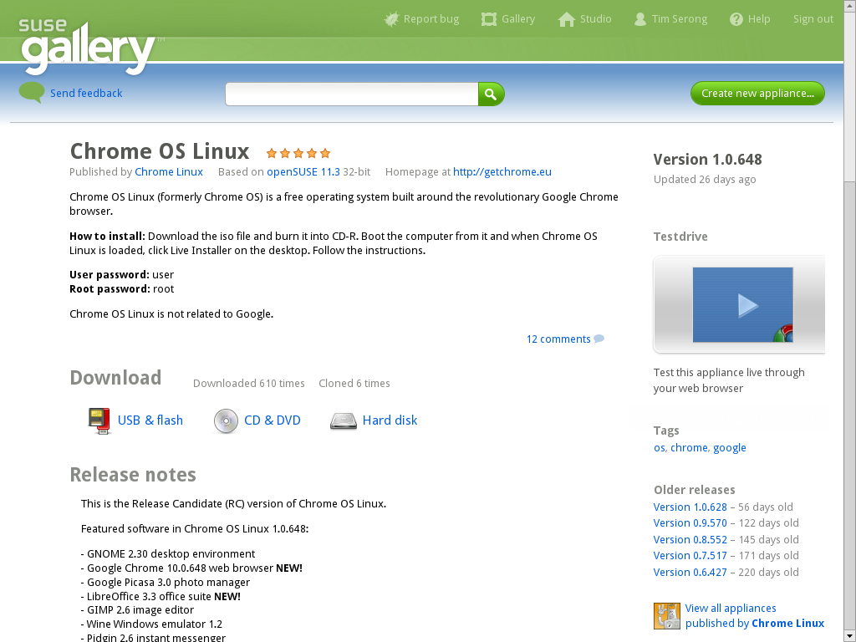
Notes:
e.g.: chrome OS (not the official one)

Slide 55
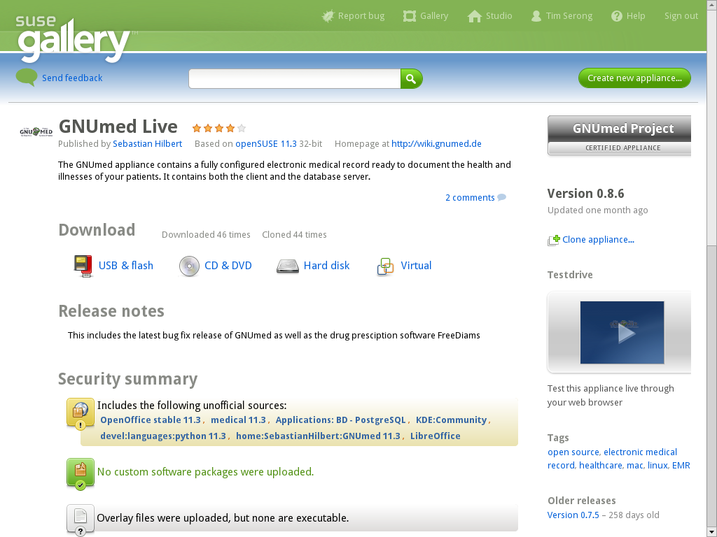
Notes:
And here GNUmed live – yes, anyone can testdrive it or clone it and make changes!

Slide 56
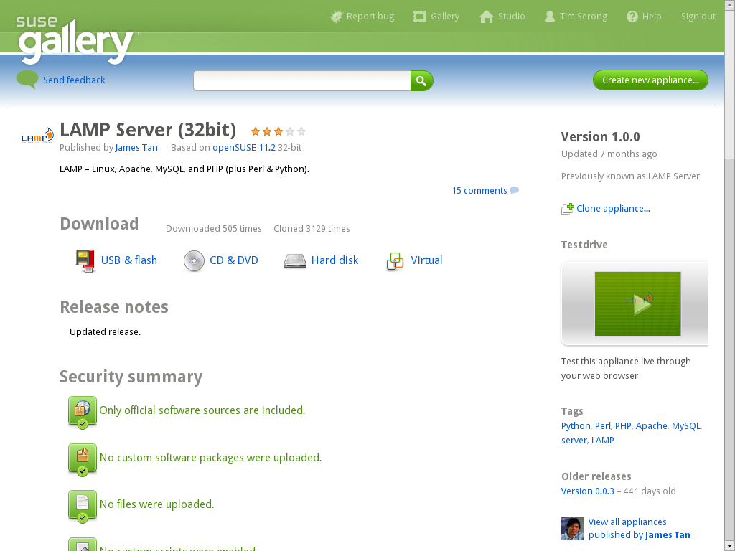
Notes:
Or a super-easy-to-deploy LAMP server.

Slide 57
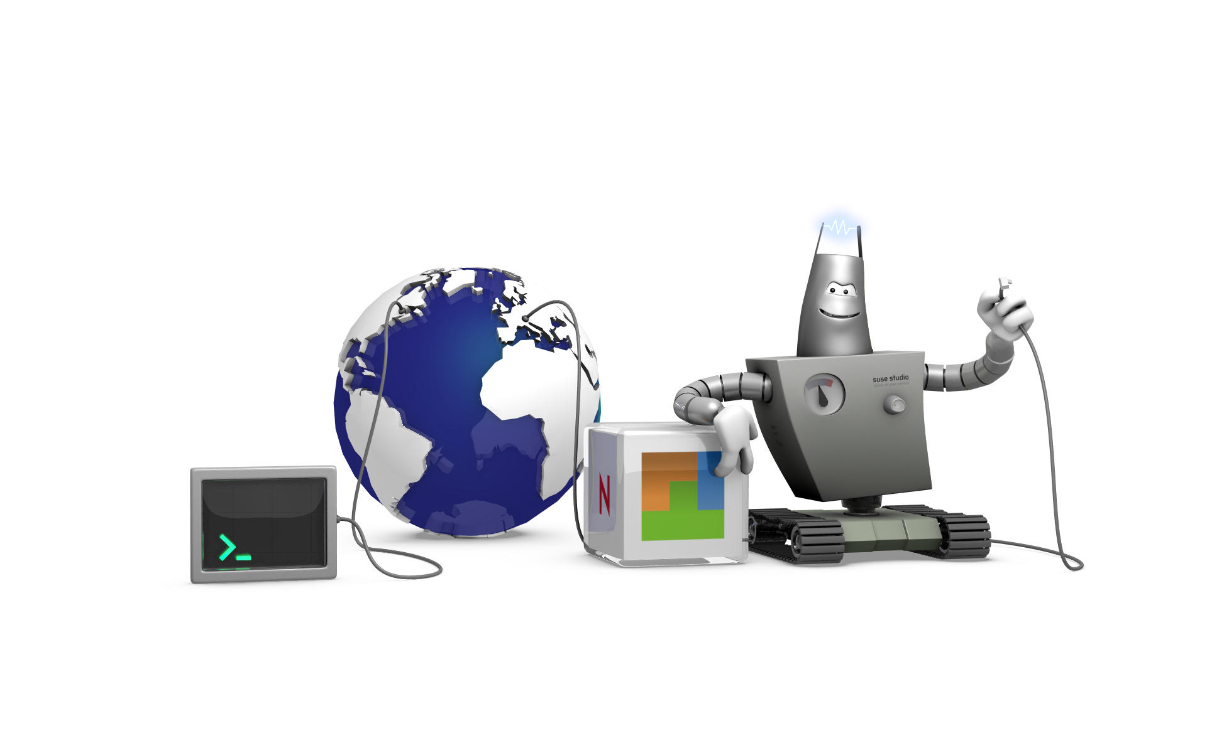
After building and deploying...
WebYaST
SUSE Manager
Notes:
SUSE Studio can take advantage of two very cool technologies:
WebYaST, a web interface to the powerful YaST tool which sysadmins love so much in (open)SUSE.
SUSE Manager, a full management and monitor tool for SUSE/openSUSE based servers .

Slide 58
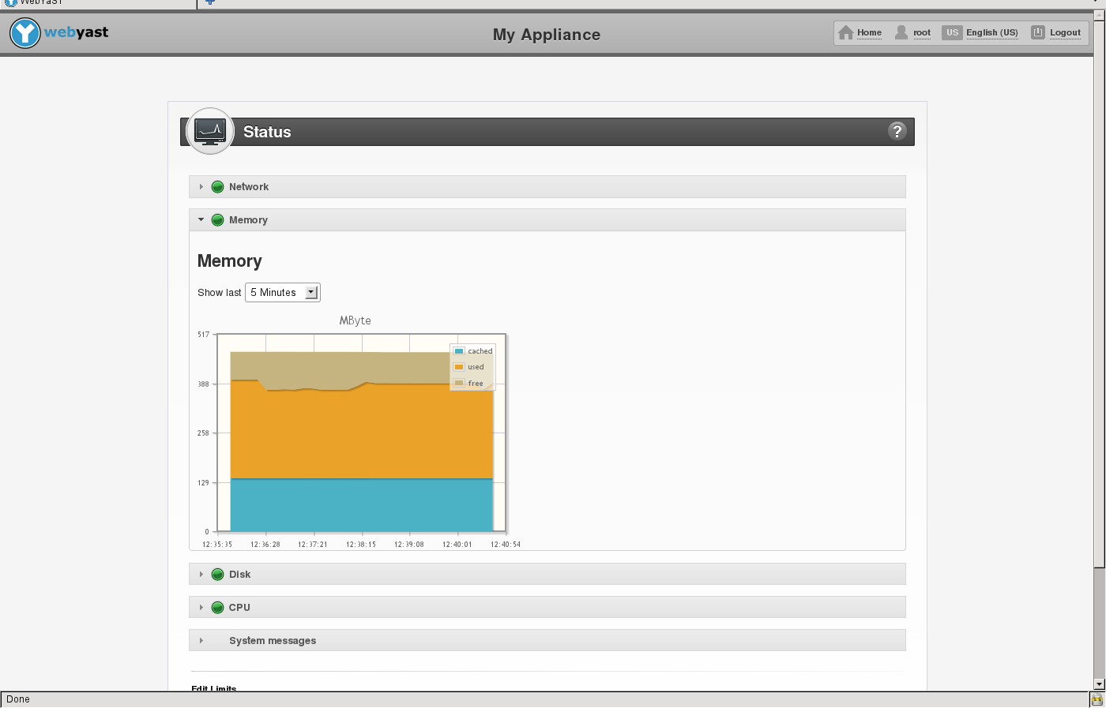
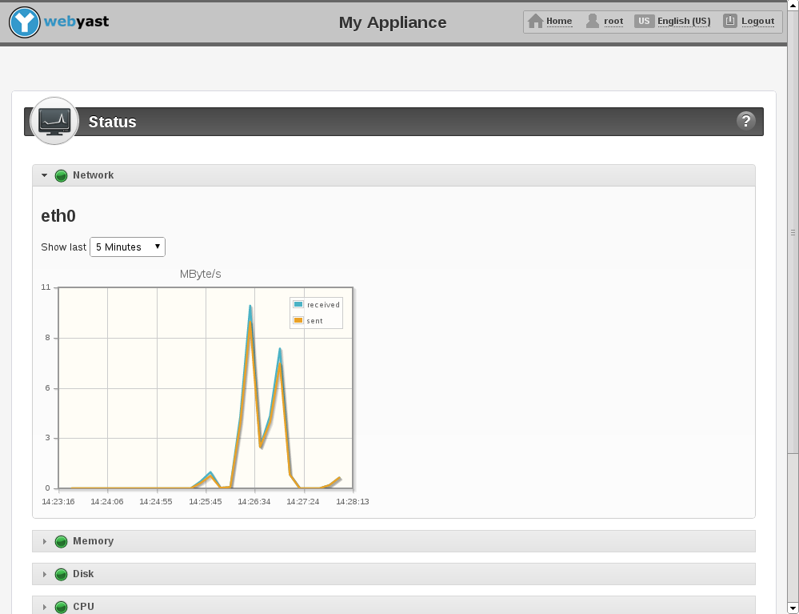

WebYaST
Monitoring
Y
Notes:
WebYaST is basically a remote YaST interface. It doesn't offer all the power of YaST but offers enough to control your box remotely and see what is going on.

Slide 59
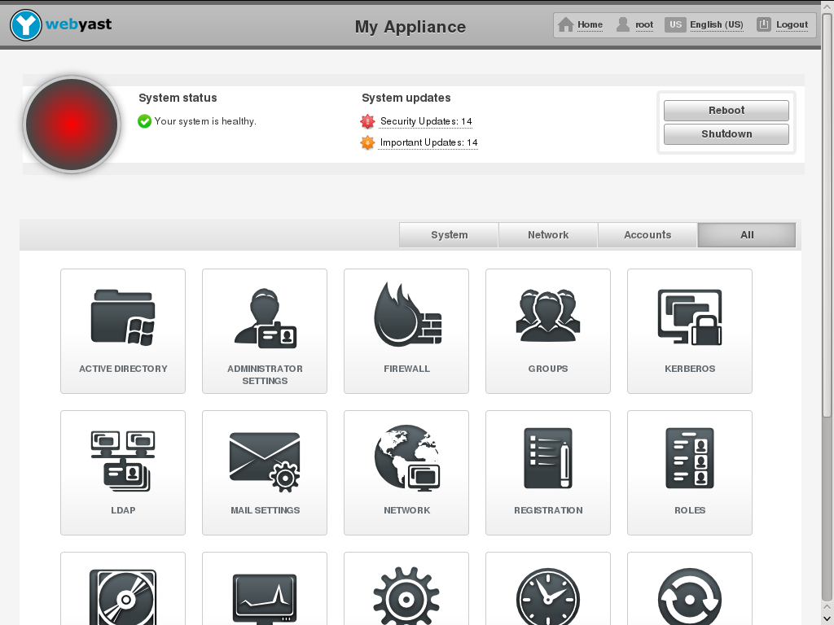
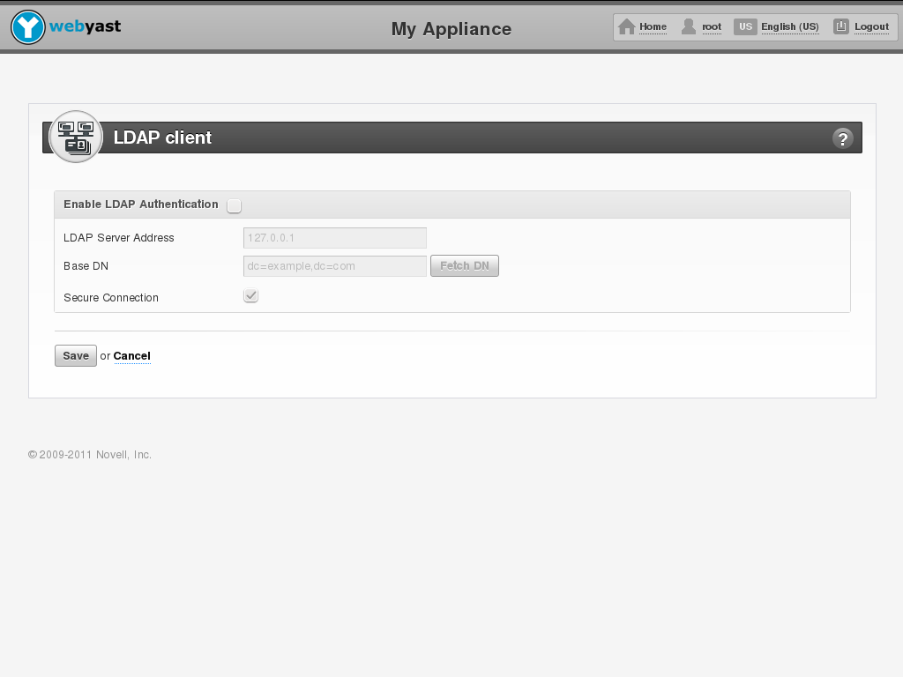
WebYaST
configuration
Y
Notes:
It allows you to change the configuration, set up services or reboot the system.

Slide 60
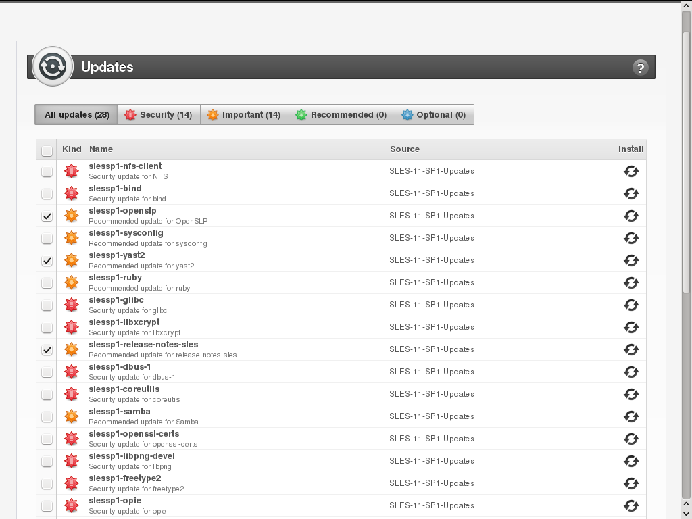
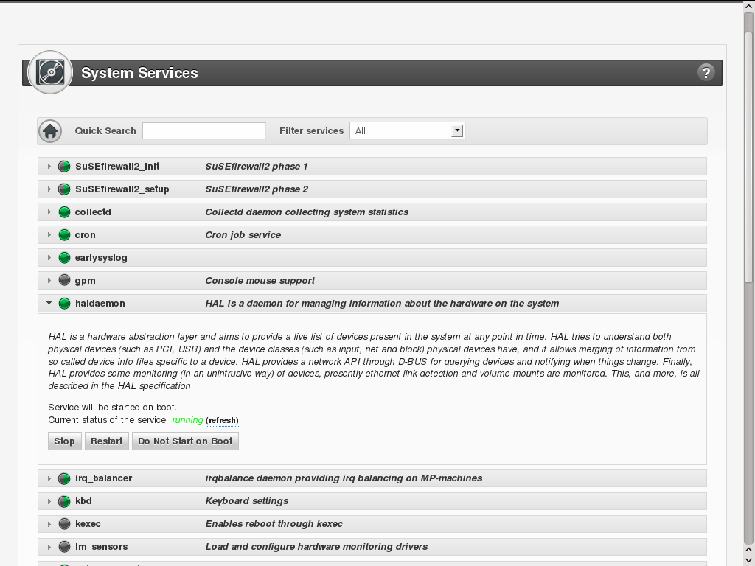
WebYaST
Managing
Y
Notes:
And it lets you take care of updating or installing and removing software.

Slide 61

SUSE Manager – if you go big
Manages physical, virtual and cloud environments
Takes care of System z deployments, appliances, SUSE Linux Enterprise, Red Hat Enterprise Linux
Notes:
When you have to manage a LOT of systems, webYaST is not enough. That's where SUSE Manager steps in.
It is not just nice for Appliances but can take care of your entire server park, be it internal, external, virtualized or in the cloud.

Slide 62
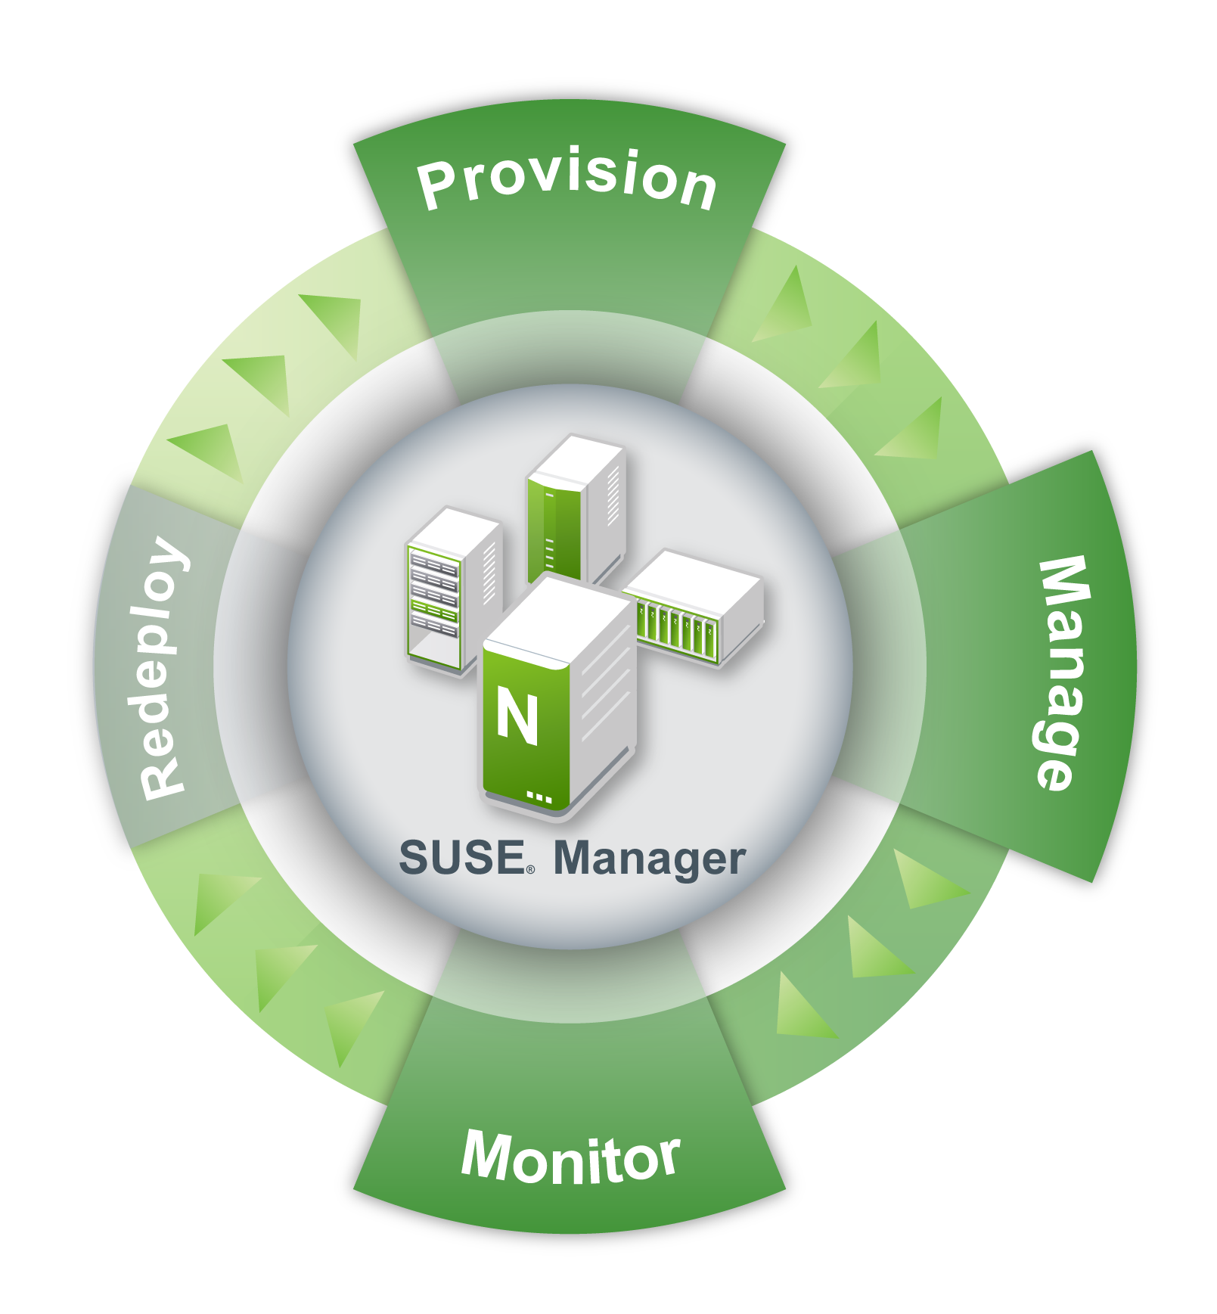
Complete lifecycle management
Configuration management
Deployment
Updating
Monitoring
Notes:
SUSE Manager can easily take care of thousands of systems, creating configuration groups, profiles and all the things you need to scale up.

Slide 63
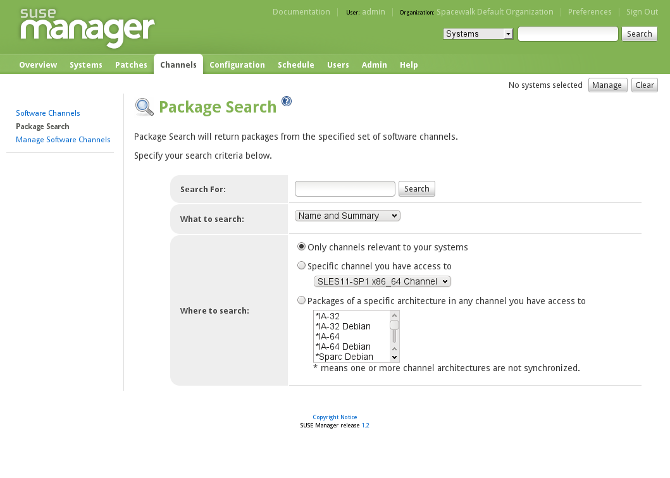
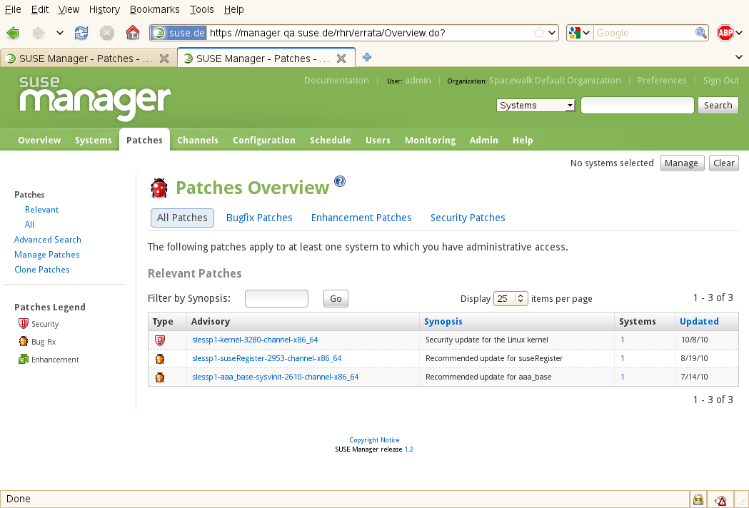
SUSE Manager
Patch & update
Notes:
SUSE Manager makes patching and updating your system a breeze

Slide 64


SUSE Manager
Monitor & alert
Notes:
And it can monitor your systems and let you know when something goes wrong and you need to take action.

Slide 65
What Next?
Try SUSE® Studio™
Build a virtual and cloud application with a few mouse clicks. Customize it to your heart's content, and share it with the world! http://susestudio.com/
SUSE Studio
Learn about the fastest way to Build, Manage and Maintain new workloads! http://www.suse.com/products/susestudio/
Notes:
So. Check out SUSE Studio on susestudio.com and play with it a bit!

Slide 66
Any Questions?
Notes:
Yes, I know it was impressive, but you might have questions nonetheless :D

Slide 67
This work is licensed under the Creative Commons Attribution-Noncommercial-Share Alike 2.5 License. To view a copy of this license, visit http://creativecommons.org/licenses/by-nc-sa/2.5/.
For other licenses contact author: Tim Serong, tserong@suse.com

